Slide 1

Enhancing Operational Efficiency in a Multispecialty Hospital
Name: Dennis
Date: XX/XX/XXXX

Slide 2
Table of Contents
Executive Summary
Introduction
Business Objectives
Methodology
Requirements Gathering (BRD and RTM)
Stakeholder Analysis and Engagement Plan
Scope Management Plan
Data Analysis
Data Visualization
Process Mapping
Risk Assessment Plan
Risk Mitigation Plan
Findings and Recommendations
Key Findings
Key Recommendations
Conclusion
Appendix

Slide 3
Executive Summary
Outline the problem, key insights, and recommended actions in 6 bullet points.
Problem:
Long patient wait times
Resource allocation challenges
Communication gaps across departments
Key insights:
Delays exceeding 30 minutes
Limited communication regarding the status of their appointments
Recommended actions:
Automating appointment scheduling
Reducing double bookings
Streamlining resource allocation

Slide 4
Introduction
Summarize the opportunity, describe the approach, and outline the key questions or hypotheses to be analyzed in 6 bullet points.
Opportunity:
1. Improve patient experience by overhauling the scheduling and communication systems to reduce wait times, cancellations, and confusion.
2. Optimize operational efficiency by addressing resource allocation, outdated systems, and inter-departmental communication gaps among doctors, nurses, and administrative staff.
Approach:
1. Conduct system-wide diagnostics to identify key inefficiencies in scheduling, resource usage, and data management using interviews, process mapping, and system audits.
2. Implement an integrated Hospital Information System (HIS) with real-time scheduling, notification, and analytics capabilities across departments.
Key questions/hypotheses:
Would integrating scheduling, billing, and record systems reduce double-bookings and patient complaints?
Can a real-time notification system significantly reduce missed appointments and patient frustration?

Slide 5
Business Objectives
Areas of improvement in 6 bullet points:
Enhance Patient Scheduling Experience
Improve Communication and Notifications
Optimize Resource Allocation
Streamline Inter-departmental Communication
Upgrade Legacy IT Infrastructure
Enable Data-Driven Decision-Making

Slide 6

Methodology

Slide 7
Requirements Gathering: Business Requirement Document (BRD)
Problem statement:
HealthFirst Care is currently challenged by outdated manual scheduling processes that result in long patient wait times and frequent double bookings. Patients experience delays exceeding 30 minutes and receive limited communication regarding the status of their appointments. Concurrently, resource allocation throughout the hospital is hampered by scheduling conflicts and a lack of real-time visibility into department availability. These issues create operational bottlenecks, reduce staff efficiency, and negatively impact patient satisfaction
Key requirements to improve operational efficiency:
Unified Scheduling System An integrated, user-friendly platform accessible to patients and staff for real-time appointment booking, cancellation, and rescheduling.
Automated Notifications System-generated SMS/email alerts for appointment confirmations, delays, cancellations, and post-consultation follow-ups.
Real-Time Resource Availability Dashboard View of doctors’ availability, room occupancy, and equipment status to prevent bottlenecks and overbooking.

Slide 8
Requirements Gathering: Business Requirement Document (BRD)
Constraints:
Budget Limitations: Deployment must stay within the defined capex/opex constraints.
Integration Feasibility: New systems must be compatible with existing hospital infrastructure and third-party platforms.
Data Privacy Compliance: Must adhere to HIPAA/GDPR or local data protection laws.
Training Requirements: All users must be trained within a limited onboarding timeframe.
Downtime Minimization: System upgrades must not disrupt ongoing hospital operations.
Acceptance criteria:
Scheduling System: ≥ 95% of patients must be able to book appointments online without support.
Notification System: Appointment alerts must be sent within 1 minute of scheduling changes
Resource Dashboard: Real-time updates must reflect changes in doctor or equipment availability within 30 seconds.
Cross-Department Communication: Inter-departmental update time must improve by 70% within 2 months post-implementation.
Analytics Tools: Dashboards must provide exportable weekly/monthly reports.

Slide 9
Requirements Gathering: Requirement Traceability Matrix (RTM)
Requirement ID | Requirement Description | Priority (MoSCoW) | Stakeholder(s) | Project Objective | Related Data File | Status
HF-R001 | If a data breach occurs, isolate affected systems immediately, notify IT security, and initiate root cause analysis. | Must Have | IT Security | Maintain data security and integrity | N/A | Approved
HF-R002 | If staff resistance continues, deploy departmental change champions. | Must Have | Administrative Staff | Ensure smooth system adoption | N/A | Approved
HF-R003 | If scheduling system fails or causes delays, revert to manual scheduling as a backup. | Must Have | IT Dept, Administrative Staff | Minimize disruption to scheduling | N/A | Approved
HF-R004 | If wait times do not improve, increase front-desk staffing during peak hours | Must Have | Front-desk Staff, Patients | Improve patient wait times | N/A | Approved

Slide 10
Stakeholder Analysis and Engagement Plan
Stakeholders:
Patients, Doctors, Nurses, Administrative Staff, IT Teams
Stakeholders’ Influence:
• High Influence, High Interest (Key Players)
• High Influence, Low Interest (Keep Satisfied)
• Low Influence, High Interest (Keep Informed)
• Low Influence, Low Interest (Monitor)

Slide 11
Stakeholder Analysis and Engagement Plan
Stakeholder engagement strategies:
Conduct regular meetings with doctors to discuss operational challenges and gather input on potential solutions
Conduct regular meetings to discuss IT project progress, challenges, and solutions.
Provide regular updates on changes to scheduling or billing systems
Establish a forum for nurses to provide feedback on patient care processes and communication systems
Stakeholder communication strategies:
Regular meetings, feedback sessions, and involvement in decision-making processes
Regular project updates, presentations on IT initiatives, and discussions on system requirements and potential benefits
Regular updates on scheduling and billing processes, training sessions on new systems, and clear channels for providing feedback or raising concerns.

Slide 12
Scope Management Plan
In-scope activities:
Automated Appointment Scheduling: Implement a system to automate the booking process.
Real-Time Updates & Notifications: Integrate email/SMS alerts to keep patients and staff informed
Double Booking Prevention: Develop mechanisms to flag and prevent overlapping appointments.
Resource Integration: Connect scheduling with resource allocation systems (rooms, equipment, staff availability)
Out-of-scope activities:
Redesigning clinical workflows or altering medical procedures.
Overhauling non-IT operational processes unrelated to scheduling.
Any enhancements outside the realm of scheduling, notifications, or resource visibility.

Slide 13
Scope Management Plan
Assumptions:
The existing IT infrastructure will support integration with a modern, cloud-based scheduling system.
Users (both patients and staff) will require minimal training due to the user-friendly design.
Legacy data can be migrated without significant disruption
Constraints:
Budget Limitations: The available budget will restrict the scale and immediacy of system upgrades and infrastructure improvements.
Other constraints such as timing and resource availability will be managed in alignment with the budget.

Slide 14
Scope Management Plan
Phases in the Work Breakdown Structure (WBS):
WBS ID | Task Name | Task Description | Milestone
1.0 | HealthFirst Care Improvement Initiative | Project Name | Completion of Business Requirements Document (BRD)
2.0 | Phases | Project Planning Requirements Analysis System Design Development Testing Implementation & Deployment Training & Support | Stakeholder sign-off on requirements
3.0 | Tasks and Sub-Tasks | Project Planning Requirements Analysis System Design Development Testing Implementation & Deployment Training & Support | Development of the new scheduling system Implementation of real-time notification systems
4.0 | Project Close | Sprint Retrospective meeting | Go-live of the new system

Slide 15
Scope Management Plan
Scope change management:
Scope Change Request Process
Approval Criteria
Stakeholder Roles
Scope Monitoring and Validation

Slide 16
Process Mapping
Process | As-Is Model | To-Be Model
Appointment Scheduling Process | Scheduler receives request and attempts to find a suitable slot using the current system | Patient efficiently schedules an appointment with automatic validation and confirmation
Patient Check-in Process | Patient provides details/fills out forms. Staff manually verifies information, potentially retrieving records | Patient checks in quickly and efficiently with minimal manual intervention or paperwork
Interdepartmental Communication Process | Admin staff contacts IT (e.g., via phone, email, potentially informal methods). | Streamlined, trackable, and efficient handling of resource requests or issue reporting between departments

Slide 17
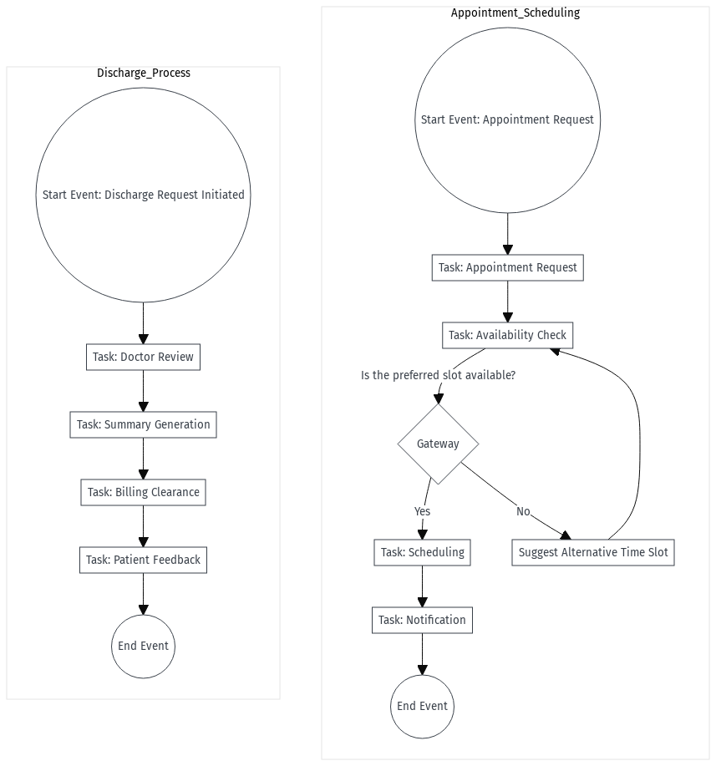
Advanced Process Mapping
Detailed workflow using the advanced BPMN model:

Slide 18
Advanced Process Mapping
Stakeholder responsibility using the Swimlane diagram:
Swimlane (Stakeholders) | Task/Activity | Description
Patients | Patient Appointment Scheduling Workflow | Is the preferred slot available?
Doctors | Discharge Process Workflow | Discharge request initiated

Slide 19
Data Analysis
Trends using a Pivot Table:

Slide 20
Data Analysis
Trends analyzed from the Pivot Table:

Slide 21
Data Analysis
Key insights:

Slide 22
Data Visualization
Average patient wait time using a horizontal bar chart:

Slide 23
Data Visualization
Bar chart highlighting overused and underutilized resources:

Slide 24
Data Visualization
Patient feedback visualized using a Pie Chart:

Slide 25
Data Visualization
Heat Map showing the efficiency of departments:

Slide 26
Risk Management Plan
Risks identified in the risk register:
Risk ID | Risk Description | Category | Likelihood | Impact | Severity | Mitigation Strategy

Slide 27
Risk Management Plan
Risks categorized based on the Risk Assessment Matrix:
Likelihood/Impact | Low Impact | Medium Impact | High Impact
High Likelihood
Medium Likelihood
Low Likelihood

Slide 28
Risk Management Plan
Elements identified in the SWOT analysis:
Strengths
Weaknesses
Opportunities
Threats

Slide 29
Risk Management Plan
Key insights from the Risk Management Plan:

Slide 30
Risk Mitigation Plan
Strategies to mitigate risks:
Risk ID | Risk Description | Category | Likelihood | Impact | Severity | Mitigation Strategy

Slide 31
Risk Mitigation Plan
Factors included in the Contingency Plan:
Risk ID | Contingency Plan

Slide 32
Risk Mitigation Plan
Risks prioritized based on the Visual Risk Matrix:
Priority Level | Risk ID & Description | Rationale | Action Urgency

Slide 33
Risk Mitigation Plan
Key insights from the Risk Mitigation Plan:

Slide 34
Findings and Recommendations

Slide 35
Key Findings
1.
2.
3.

Slide 36
Key Recommendations
1.
2.
3.
4.

Slide 37
Conclusion
Provide a summary of observations in 3–5 bullet points.

Slide 38


Slide 39
Appendix
Note: Use this section to include supplementary materials, such as charts, graphs, data tables, and other supporting documents, for this Business Analysis (BA) report.

